Slide 1
Wide World Importers
Sales Analysis May 2015 – May 2018

Slide 2
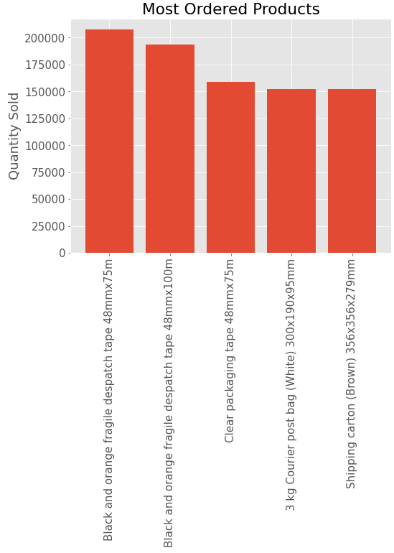
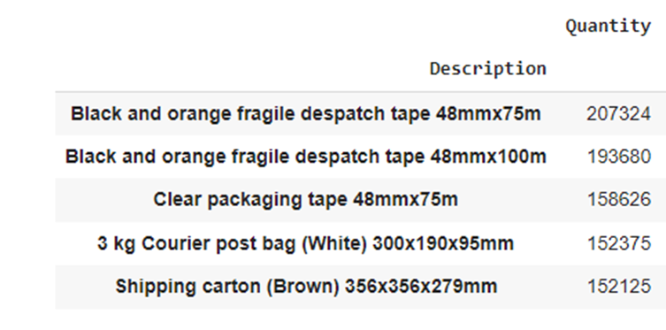
Best Selling Products
Top 5 Most Ordered Products
Most Ordered Product
Black and orange fragile despatch tape 48mmx75m
Total Orders: 207,324

Slide 3
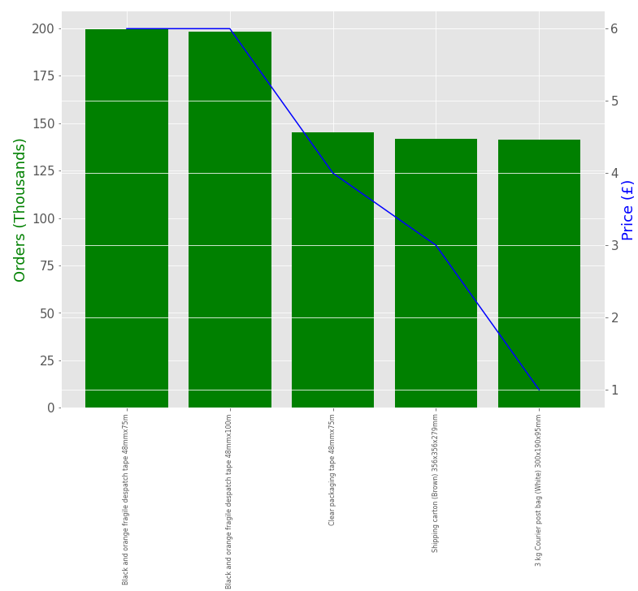
Best Selling Products Price Points
The top 5 most ordered products each have modest retail price points at £6 or under.

Slide 4
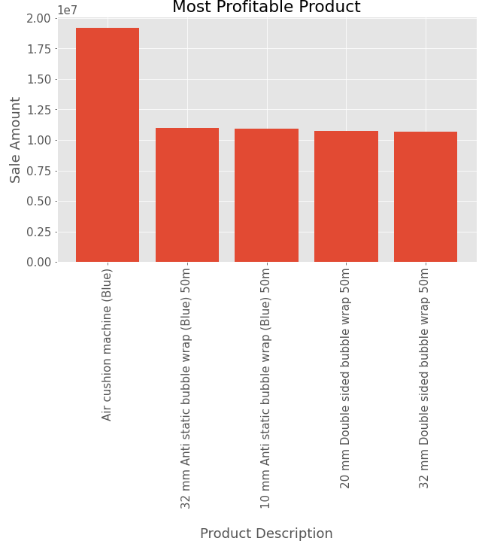

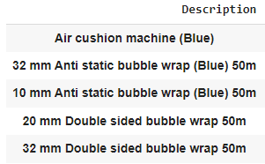
Most Profitable Products
Top 5 Products with the Highest Revenue Income
Most Profitable Product
Air cushion machine (Blue)
Total Revenue Income: £ 19,160,010

Slide 5
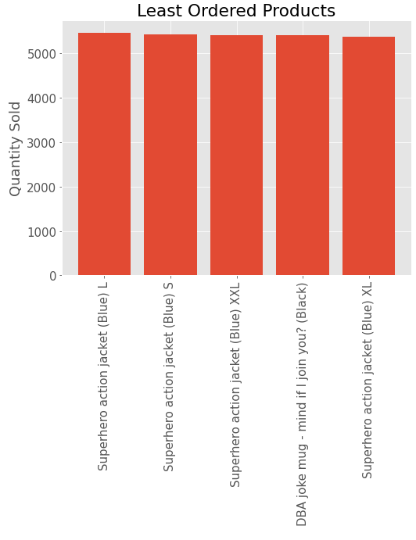
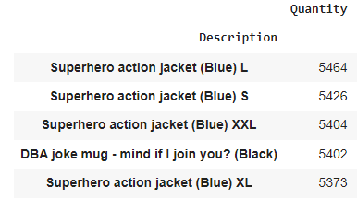
Least Ordered Products
Top 5 Least Ordered Products
Least Ordered Product
Superhero action jacket (Blue) XL
Total Orders: 5373

Slide 6
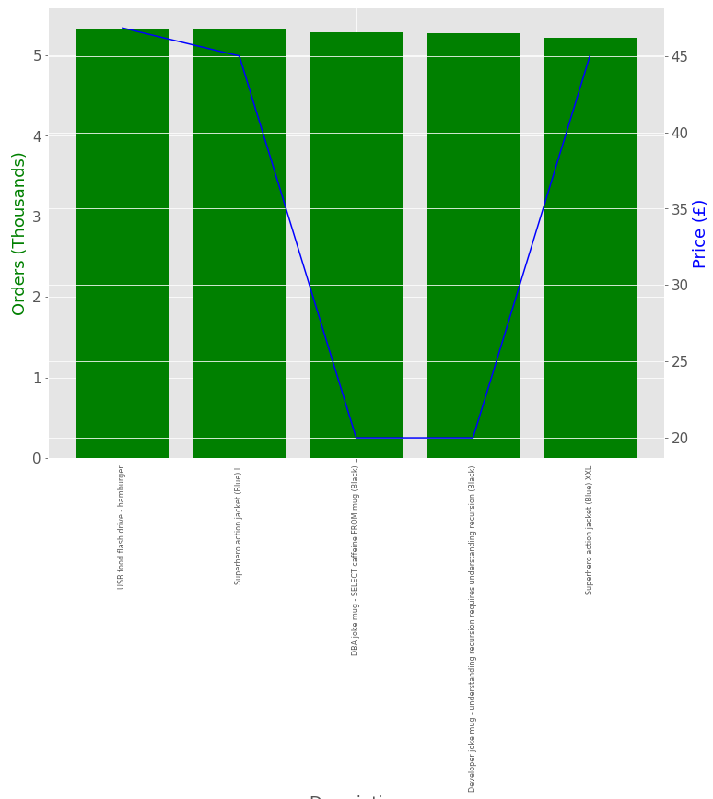
Least Ordered Products Price Points
The top 5 least ordered products are novelty/joke items with a price range of £20 - £45.

Slide 7
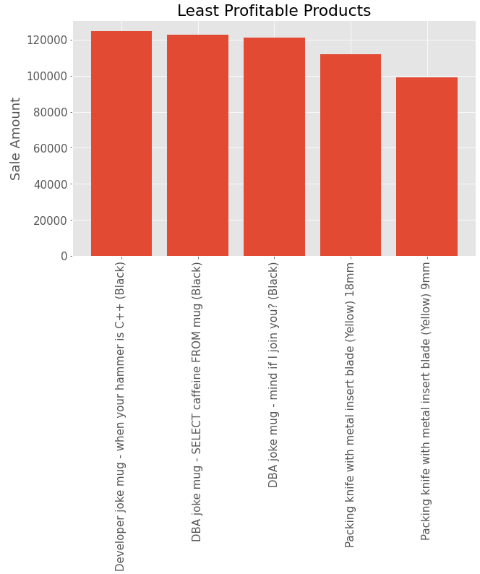

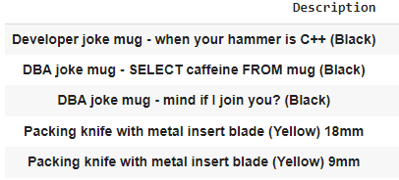
Least Profitable Products
Top 5 Products with the Lowest Revenue Income
Least Profitable Product
Packing knife with metal insert blade (Yellow) 9mm
Total Revenue Income: £ 98,948

Slide 8
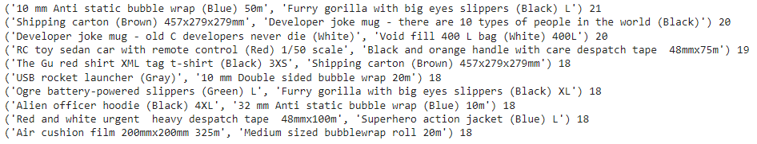
Top 10 Products Bought Within an Order of 2
10 mm Anti static bubble wrap (Blue) 50m & Furry gorilla with big eyes slippers (Black)
21 Orders
Reviewing the most common pairs of items bought together within an order, there does not seem to be a clear correlation between the items sold.

Slide 9
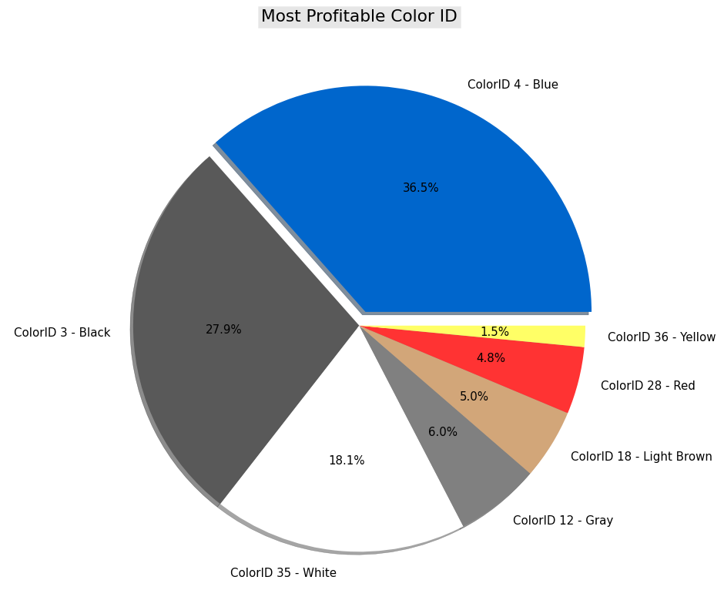
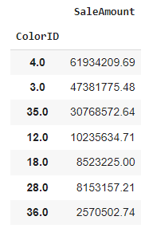
Most Profitable ColorID
Top ColorID’s with the Highest Revenue Income
Most Profitable ColorID
Blue – ColorID 4
Total Revenue Income: £ 61,934,209

Slide 10
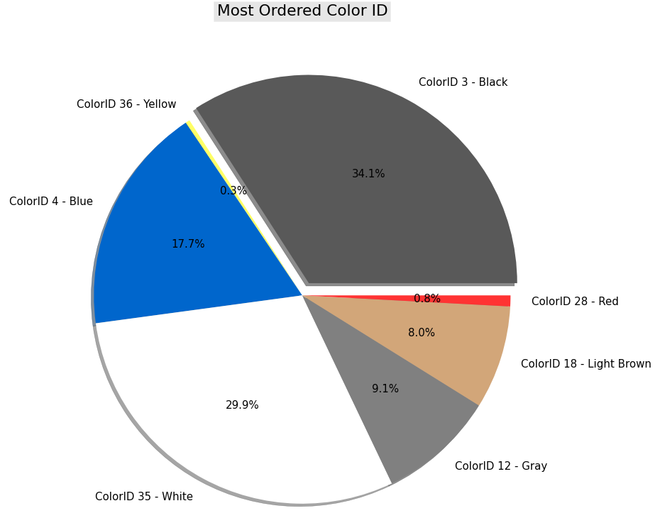
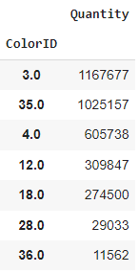
Most Ordered ColorID
Top ColorID’s with the Most Orders
Most Ordered ColorID
Black – ColorID 3
Total Orders: 1,167,677

Slide 11
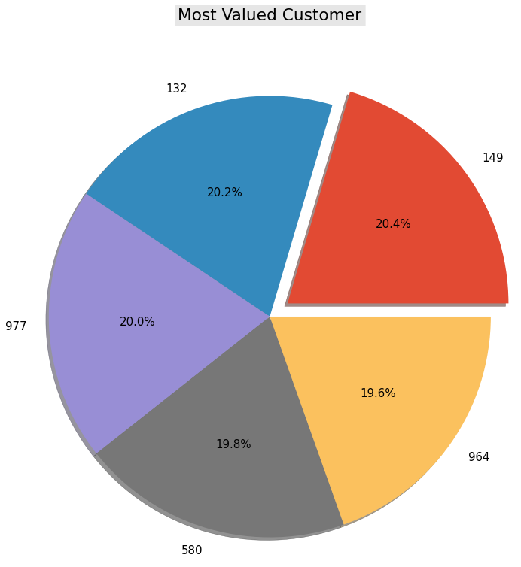

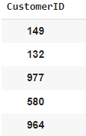
Most Valued Customer
Top Customers with the Highest Total Sales
Most Valued Customer
CustomerID 149
Total Orders: £662,878

Slide 12
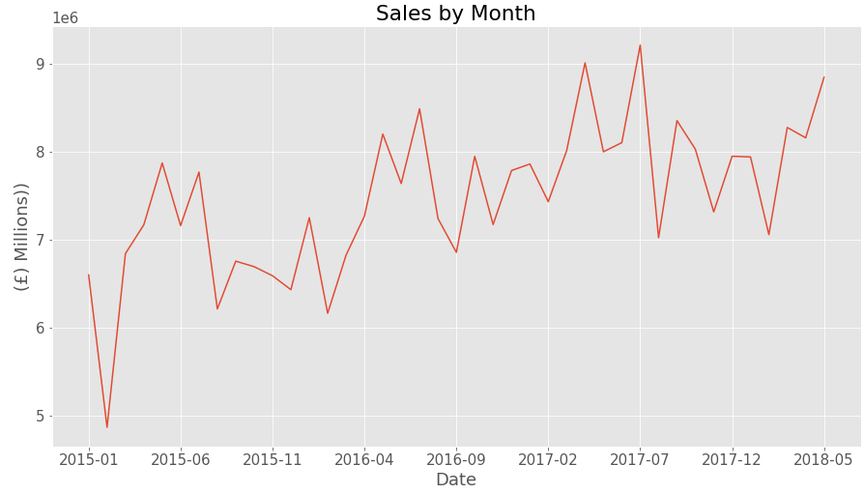
Analysing Monthly Sales Data Jan 2015 – May 2018
There is an increase of sales during each of the years summer months.

Slide 13
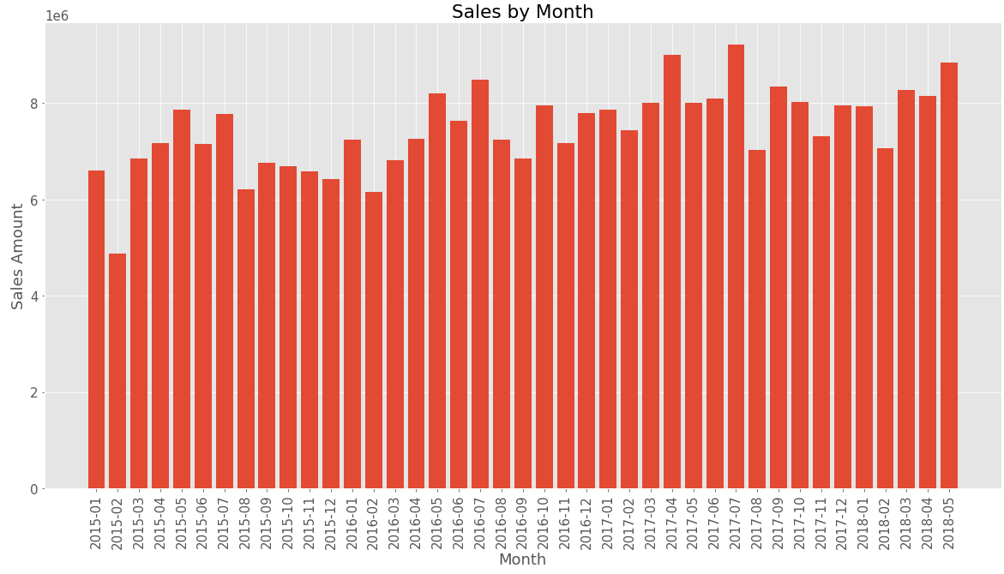
Analysing Monthly Sales Data Jan 2015 – May 2018
There is an increase of sales during each of the years summer months.

Slide 14




The Best & Worst Months of Sales Jan 2015 – May 2018
Best Sales Months
Worst Sales Months
The best month of sales is July 2017.
July 2017 Total Sales: £9,210,146
The worst month of sales is February 2015.
February 2015 Total Sales: £4,866,715

Slide 15
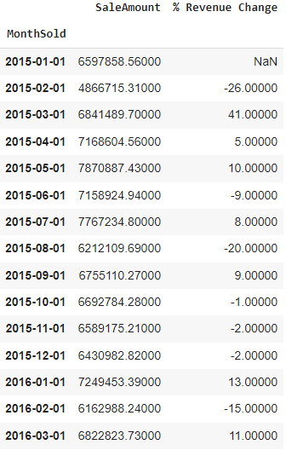
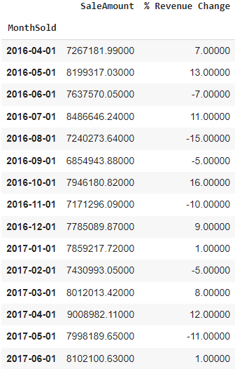
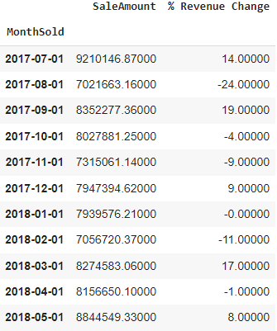
Sales Revenue Percentage Changes Jan 2015 – May 2018
There is a year on year increase of sales from Jan 2015 to May 2018.
There is not a positive month on month revenue change.
There has been a 2.57% revenue increase in sales from May 2017 to May 2018 when compared to the revenue of May 2016 to May 2017.

Slide 16
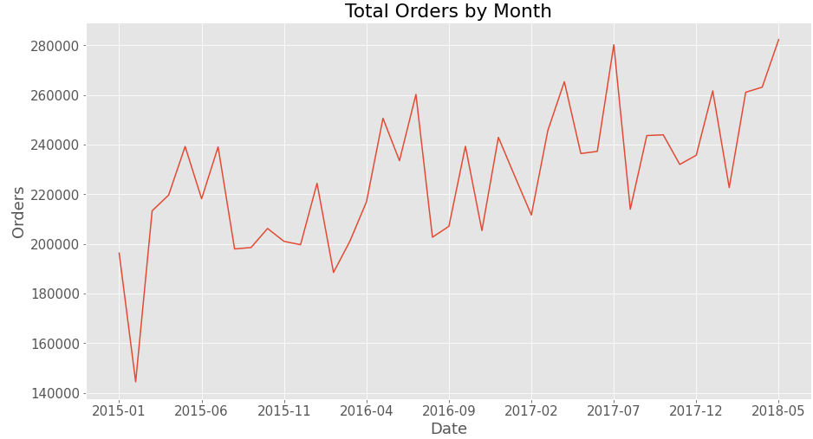
Analysing Monthly Orders Data Jan 2015 – May 2018
There is an increase of orders during during each of the years summer months.

Slide 17
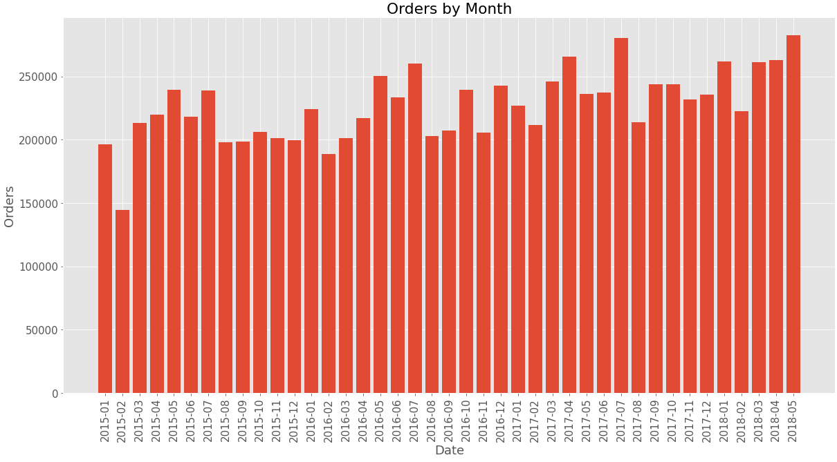
Analysing Monthly Orders Data Jan 2015 – May 2018
There is an increase of orders during during each of the years summer months.

Slide 18
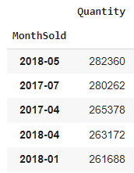
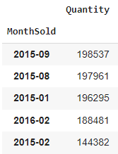
The Best & Worst Months of Orders Jan 2015 – May 2018
Best Orders Months
Worst Orders Months
The best month of orders is May 2018.
May 2018 Total Orders: 282,360
The worst month of Orders is February 2015.
February 2015 Total Orders: 144,382

Slide 19
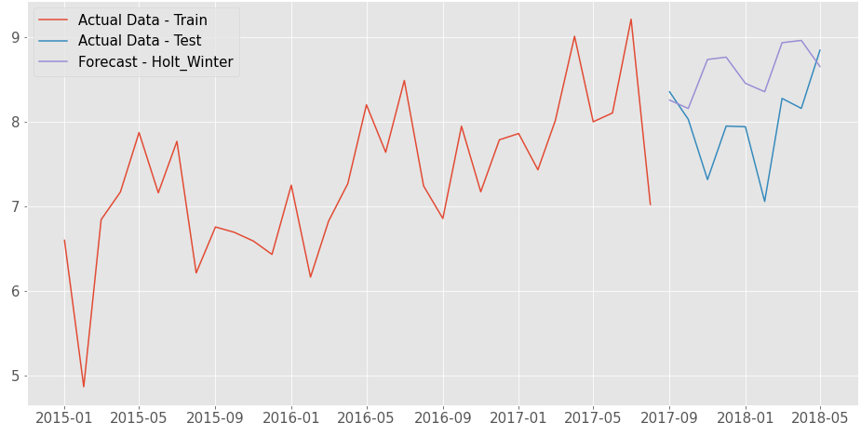
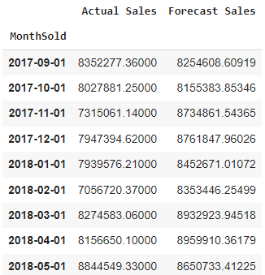
Forecasting Future Monthly Sales – May 2018 – May 2019
Using the Time Series Forecasting Model Holt-Winter-Method, actual sales data is used to forecast future sales.
Visualising the forecasted sales values against the actual sales.

Slide 20
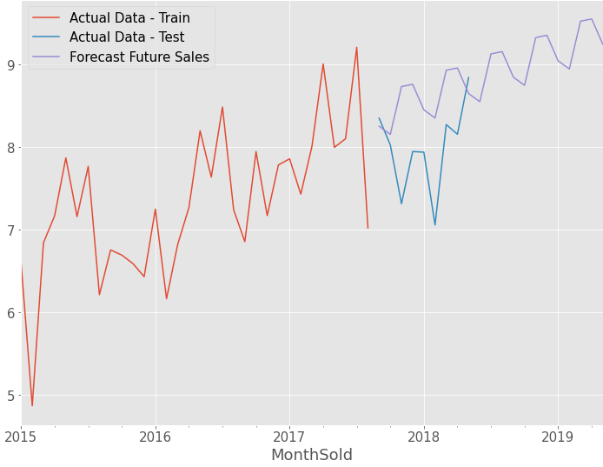
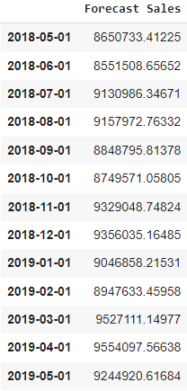
Forecasting Future Monthly Sales – May 2018 – May 2019
Monthly sales forecast for the next 12 months.
Visualising the forecasted sales for the next 12 months
As with prior years, we can expect a positive revenue increase from May 2018 to May 2019

Slide 21
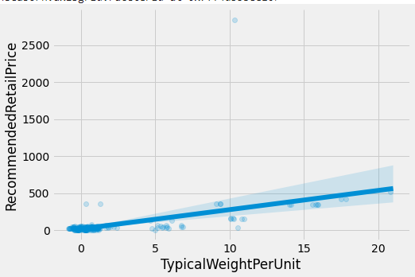
Predicting Future Product Prices
When analysing the stock warehouse data, I identified a positive upward trend between the weight of a product and retail price, this can be seen within the Linear Model Plot.
With this information I decided to experiment with two different Linear Regression models with an aim of returning an accurate scientific prediction of retail prices for new products that have not yet been allocated a price.
The Linear Regression Model learns patterns from the historic data it is provided and tuned in a way to output accurate predicted values.

Slide 22




Predicting Future Product Prices
Model 1
Model 2
The average retail price of a product with a weight of 1kg is £54.
As the model’s prediction is £10 off a realistic prediction some fine tuning is required before coming into use.
Model 1 takes an input of weight.
With a input of 1kilogram, the Linear Regression model predicts a retail price of £44.35
Model 2 takes an input of weight and ColorID.
With a input of 1kilogram and ColorID of 4 the Linear Regression model predicts a retail price of £45.46

Slide 23
Security of Data
Addressing concerns of confidentiality and complying with the UK General Data Protection Regulations, no identifiable or confidential information is available within the source data and subsequent analysis.
There are also no concerns with regards to the orders, product, stock and related data that could potentially damage business operations.

Slide 24
Summary
1. Most Ordered Product
Black and orange fragile despatch tape 48mmx75m
Total Orders: 207,324
2. Most Profitable Product
Air cushion machine (Blue)
Total Revenue Income: £ 19,160,010
3. Least Ordered Product
Superhero action jacket (Blue) XL
Total Orders: 5373
4. Least Profitable Product
Packing knife with metal insert blade (Yellow) 9mm
Total Revenue Income: £ 98,948
5. Most Ordered ColorID
Black – ColorID 3
Total Orders: 1,167,677
6. Most Profitable ColorID
Blue – ColorID 4
Total Revenue Income: £ 61,934,209
7. Most Valued Customer
CustomerID 149
Total Orders: 662,878
8. Top Items Bought Together
10 mm Anti static bubble wrap (Blue) 50m & Furry gorilla with big eyes slippers (Black)
Total Orders: 21 Orders

Slide 25
Summary Continued
9. Best Month of Sales
July 2017
Total Sales: £9,210,146
10. Best Month of Orders
May 2018
Total Orders: 282,360
11. Worst Month of Sales
February 2015
Total Sales: £4,866,715
12. Worst Month of Orders
February 2015
Total Orders: 144,382
There was a 2.57% revenue increase in sales from May 2017 to May 2018 when compared to the revenue of May 2016 to May 2017
Forecasting the next years sales revenue we can expect a sales revenue increase of 4.98%
Sales and Orders increase during the summer months

